Slide 1



2024 3rd International Conference on Advancement in Electrical and Electronic Engineering (ICAEEE),
25-27 April, 2024, Gazipur, Bangladesh
VIoT: A Voice and IoT Controlled
Unmanned Automated Vehicle
Authors
Naimur Rahman Muhammad Sheikh Sadi Md. Abu Saeed
Department of Computer Science and Engineering
Khulna University of Engineering & Technology
Presented by
Naimur Rahman

Slide 2
Overview
Introduction and Background
Software Design
Bengali Voice Commands and Data Passing
Communication Systems
Hardware Design
Experimental Analysis
Application, Future work and Conclusions

Slide 3
Introduction
Focus is on developing a vehicle control system integrating Bengali voice commands and remote-controller controls efficiently that works precisely in short range and is affected by a minimal delay in long range.
Implementation of multi-threading and parallel execution techniques optimizing data processing and enhances system performance.
This methodology opens up various practical applications.

Slide 4
Background
Existing systems often lack support for diverse control methods like voice commands and remote controller inputs.
Challenges include accuracy/reliability of voice recognition systems as well as precision in different distances with short range and long range adaptability.

Slide 5
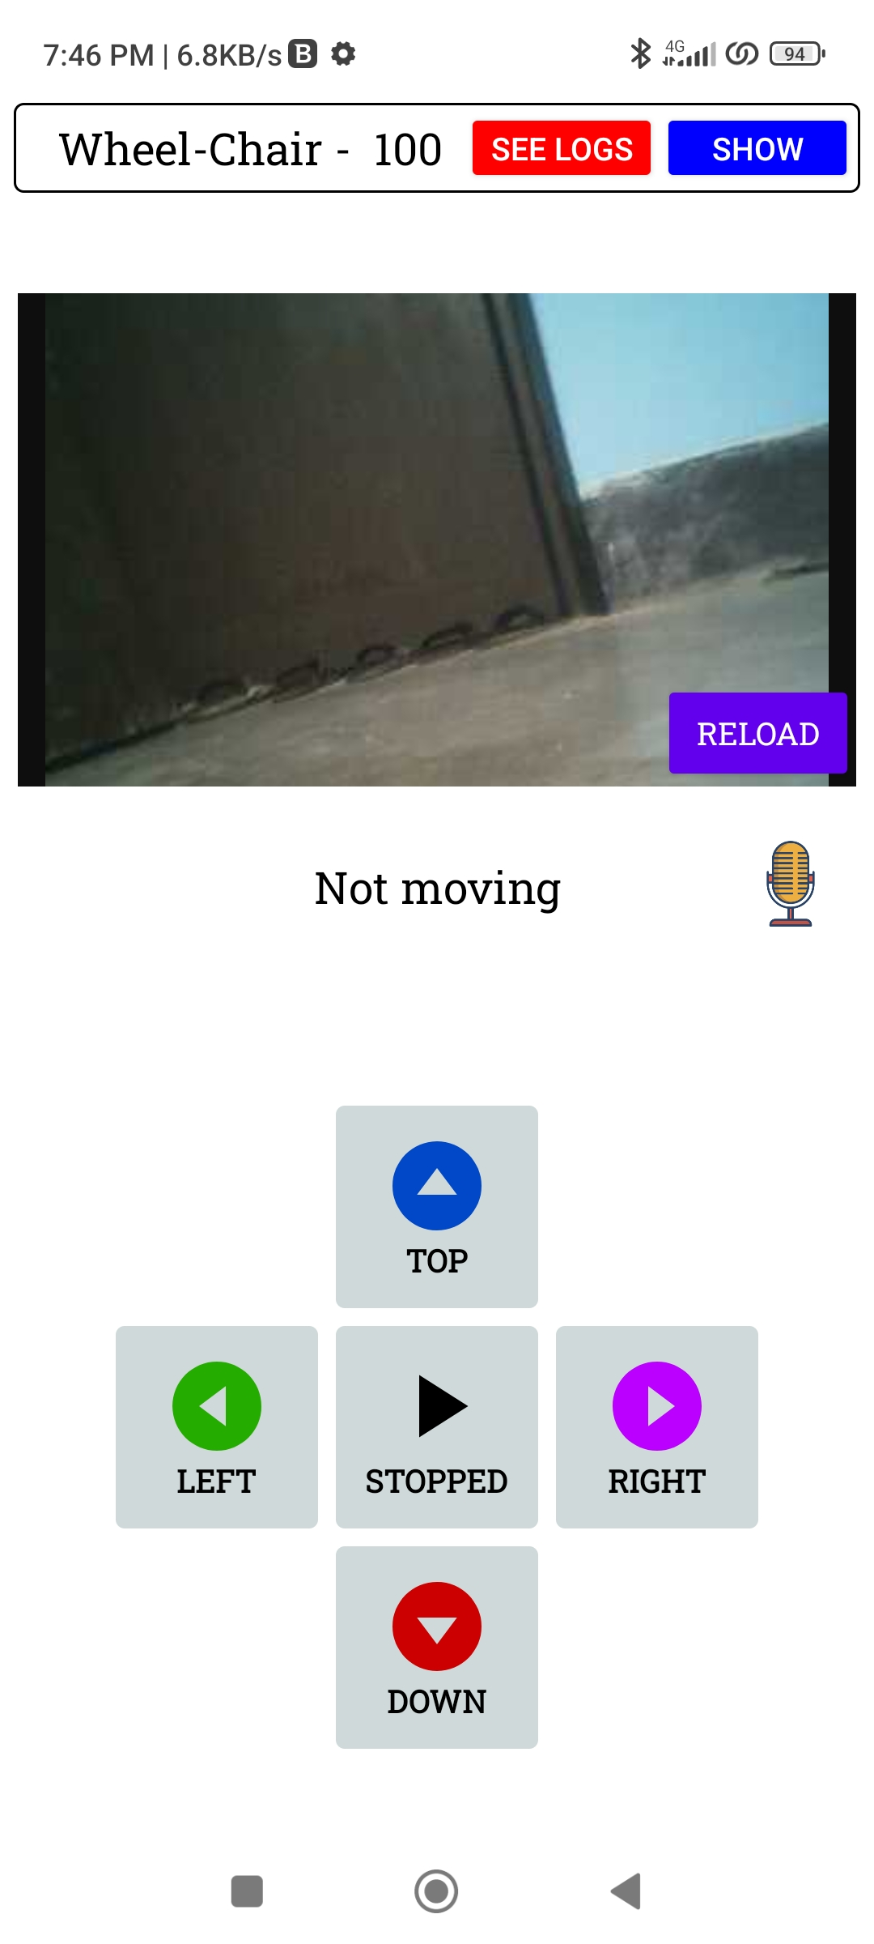
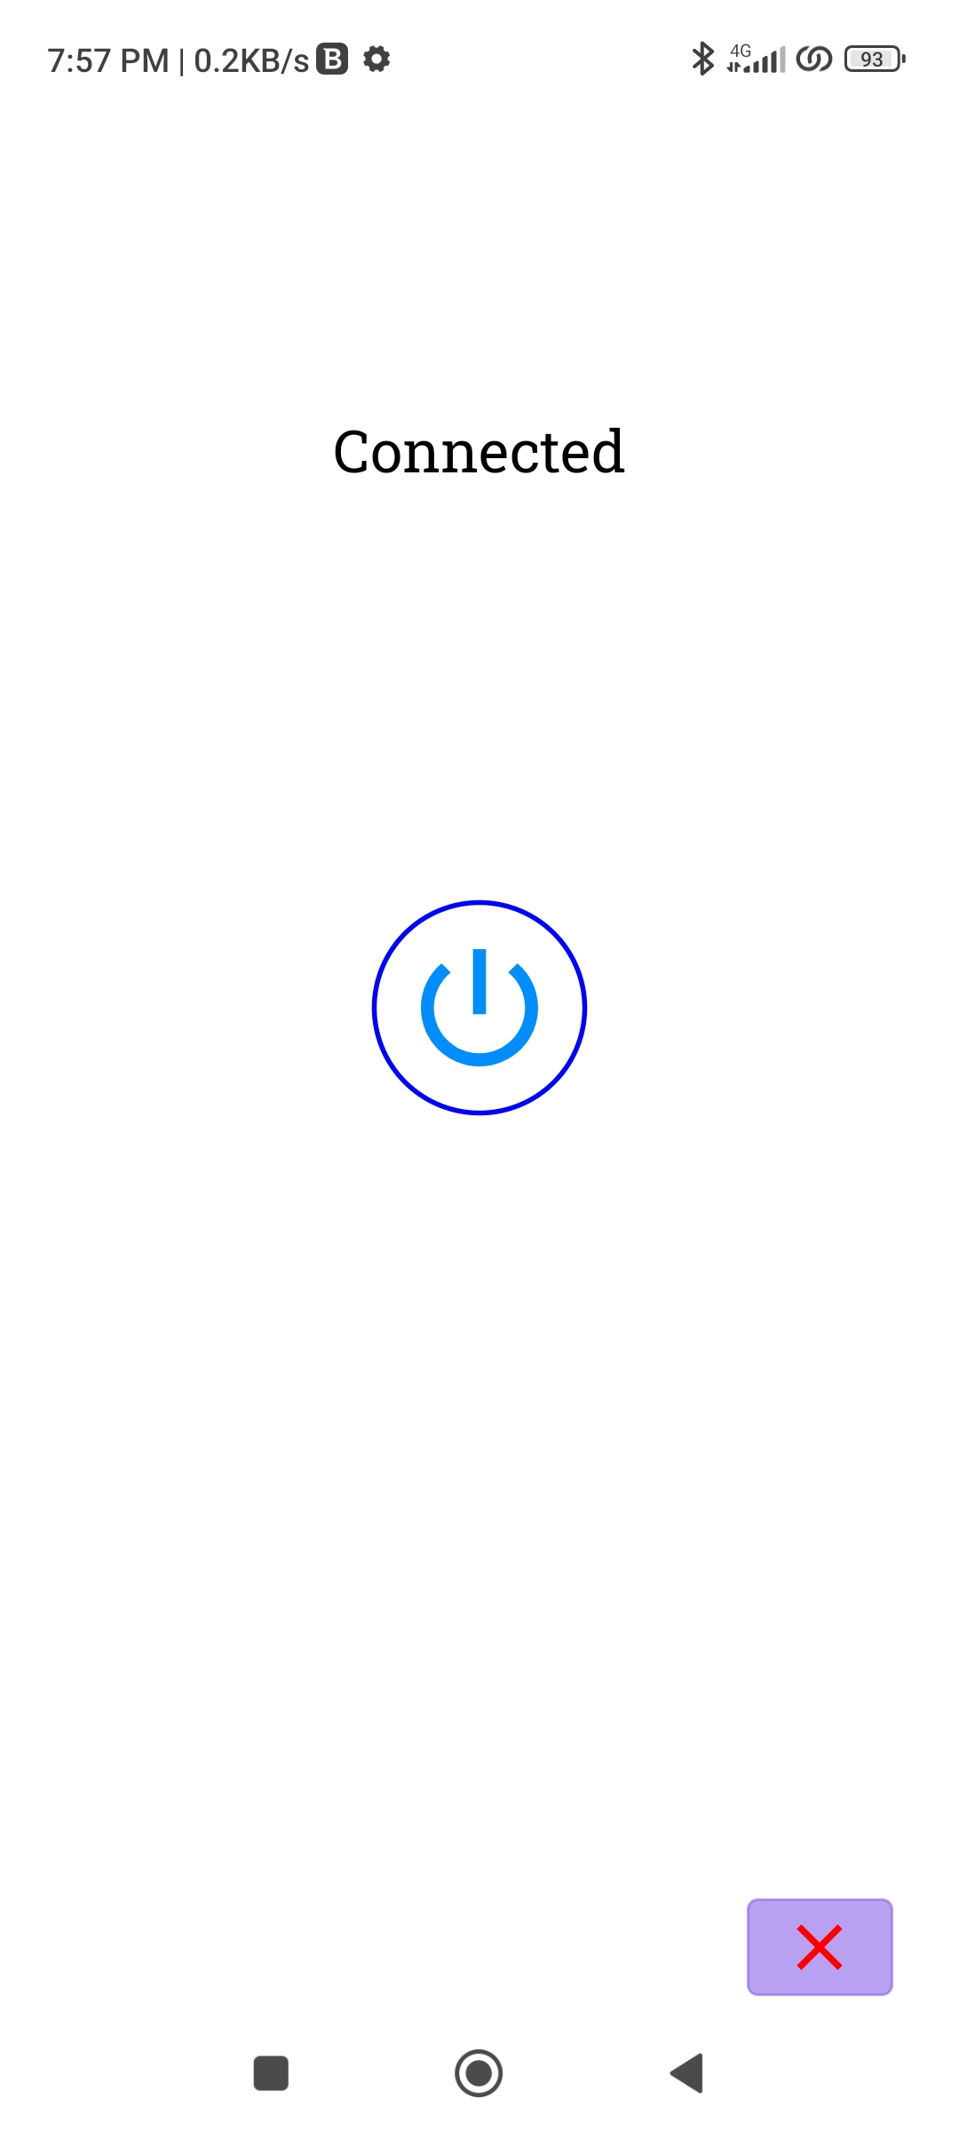
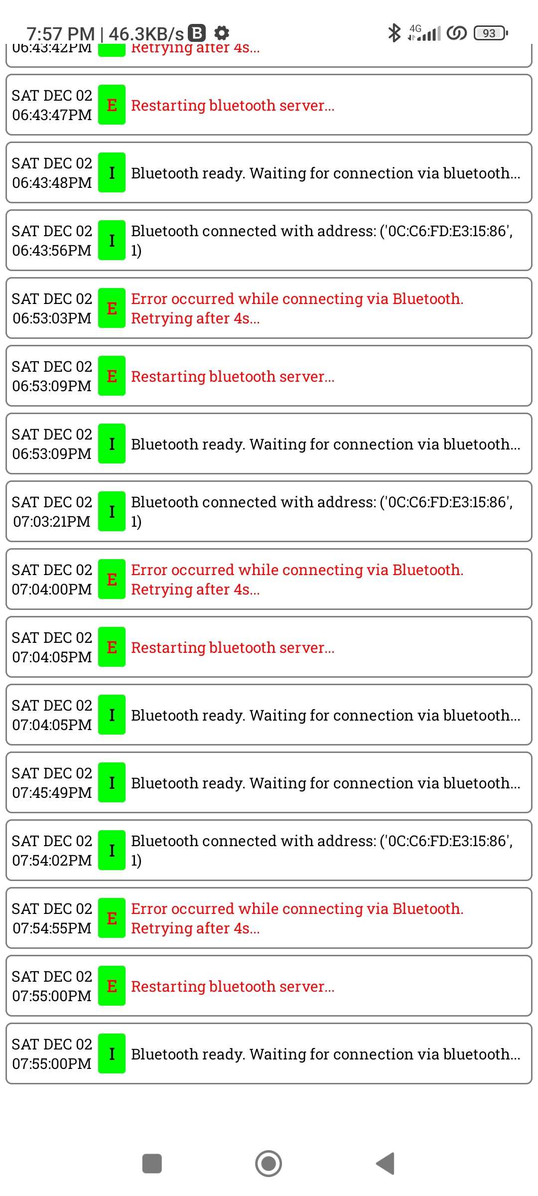
Software Design
Consists of several components:
Login system with instructions
Connection establishment
Camera view
Speech recognition API
Remote controller: Controller inputs are converted into integer values and passed though
Log cats

Slide 6
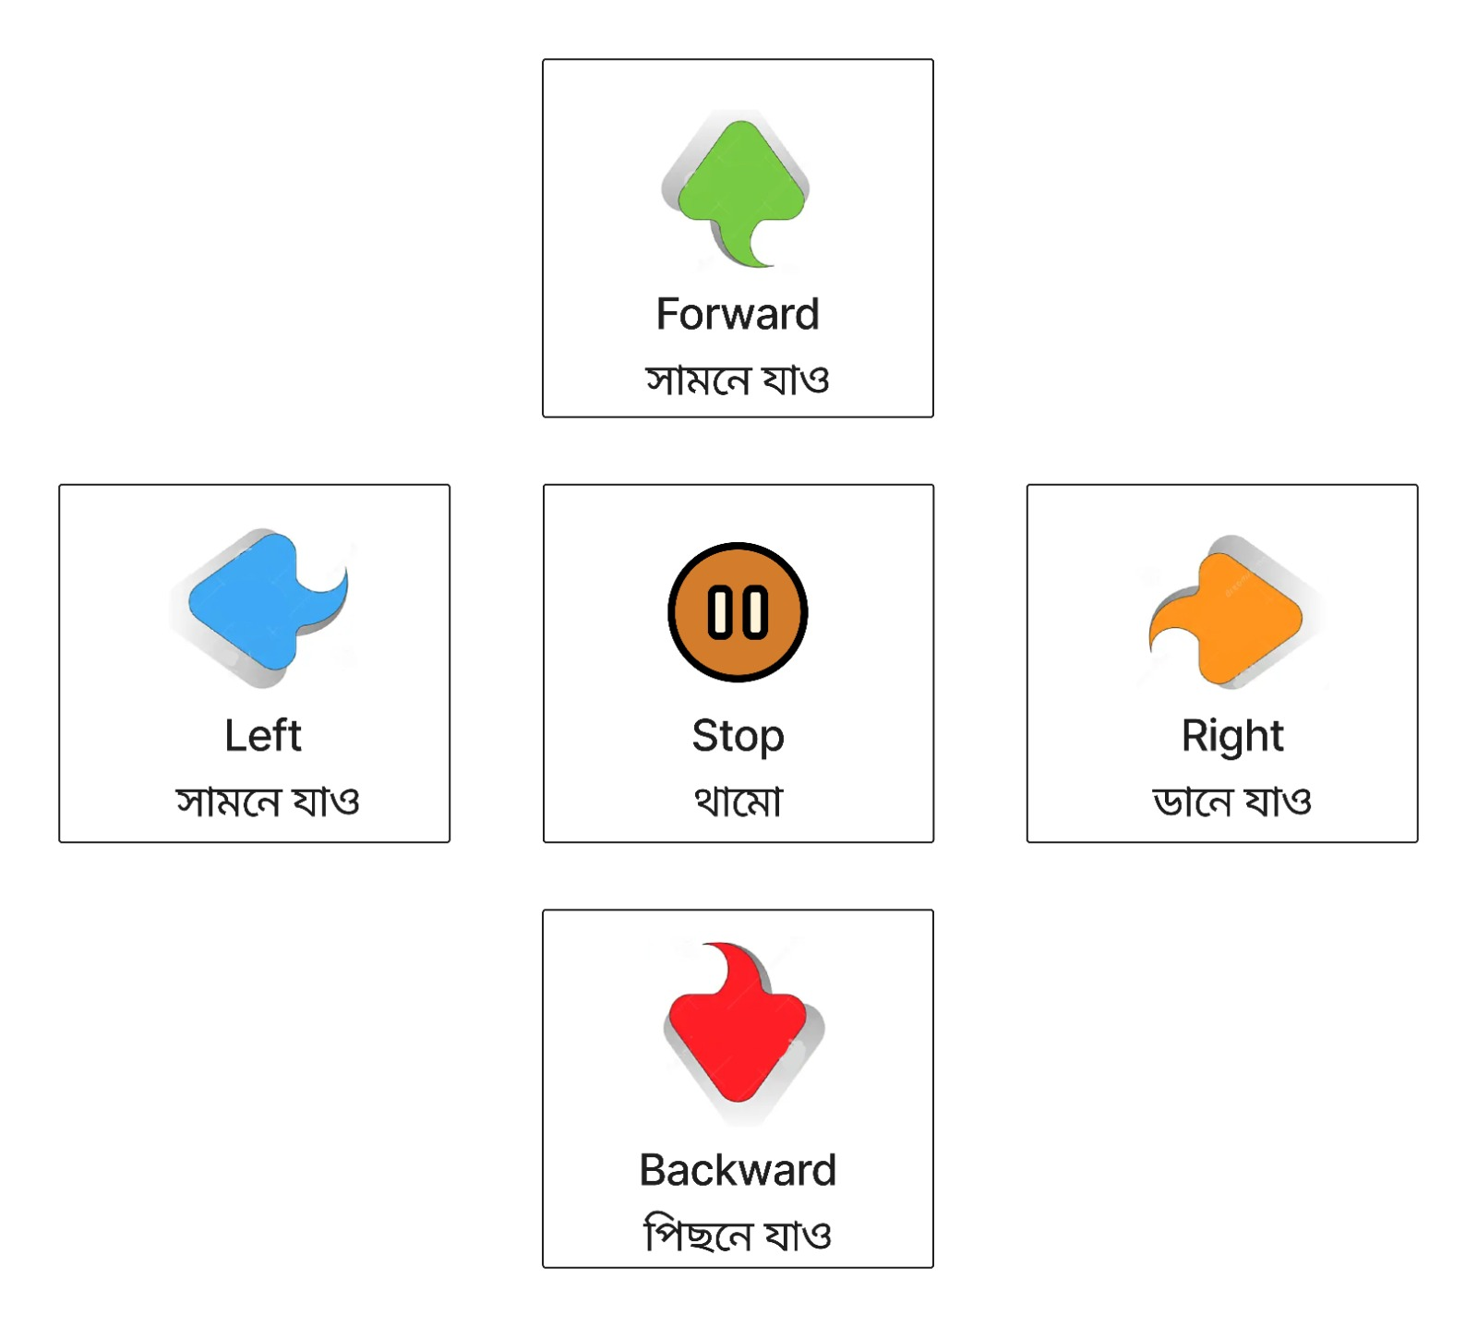
Bengali Voice Commands
বামে যাও (Bame Jao) -> Left Command -> 1
ডানে যাও (Dane Jao) -> Right Command -> 2
সামনে যাও (Samne Jao) -> Forward Command -> 3
পিছনে যাও (Pichone Jao) -> Backward Command -> 4
থামো (Thamo) -> Stop Command -> 5
These commands are first optimized by the Levenshtein algorithm and Optimized strings are converted into integer values. The Levenshtein algorithm is -
An optimization algorithm
A dynamic programming technique used to measure the similarity between 2 strings
employed to enhance the accuracy of recognizing spoken commands

Slide 7
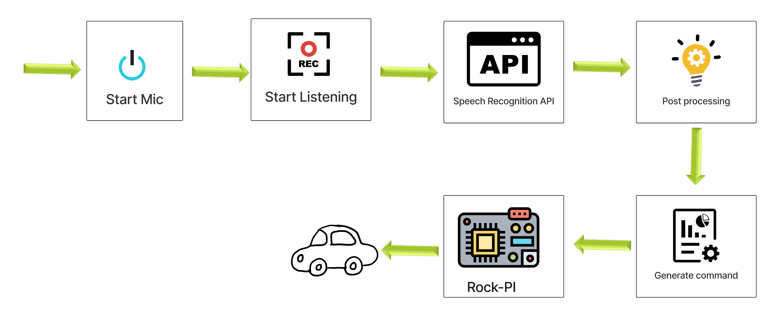
Data Passing
2 approaches:
Web Socket for only sending commands
Less latency
Firebase database
Has more latency as it is a storage having extra protection layers

Slide 8
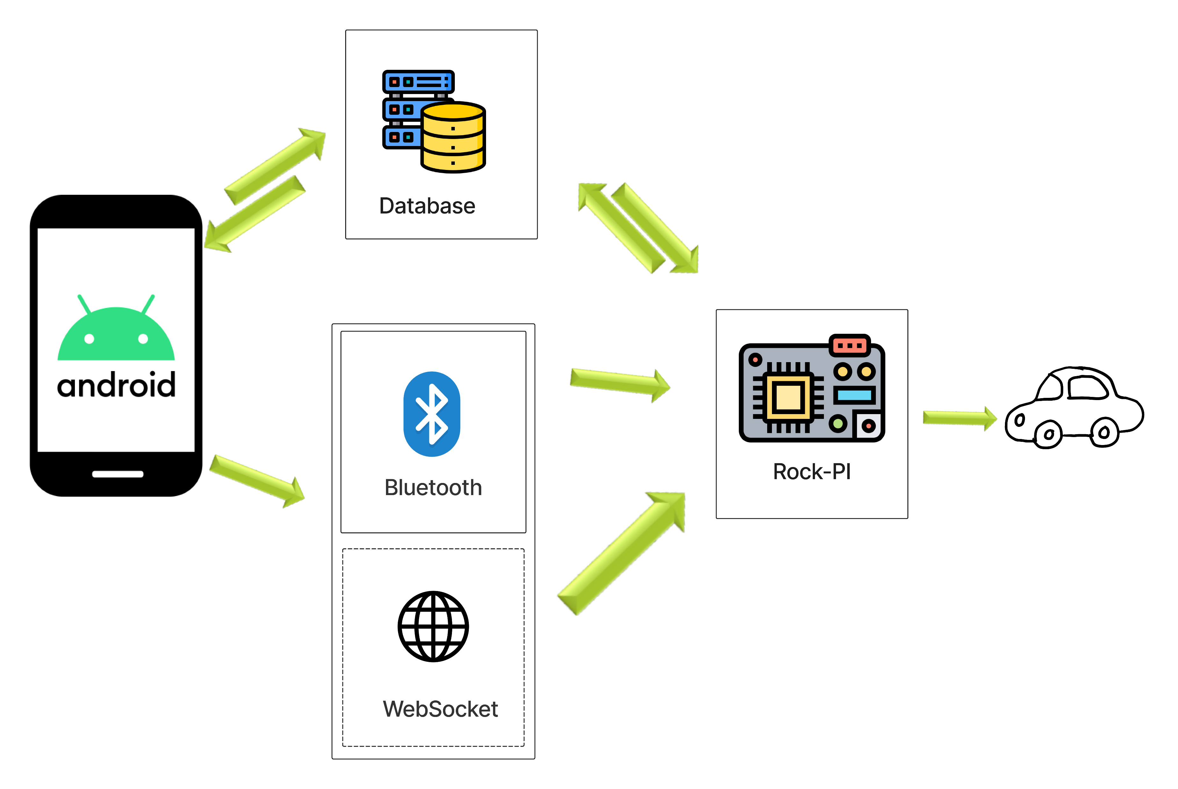
Communication System: IoT
Long range data communication from anywhere in the world
Accessed using internet
Uses Web Socket

Slide 9
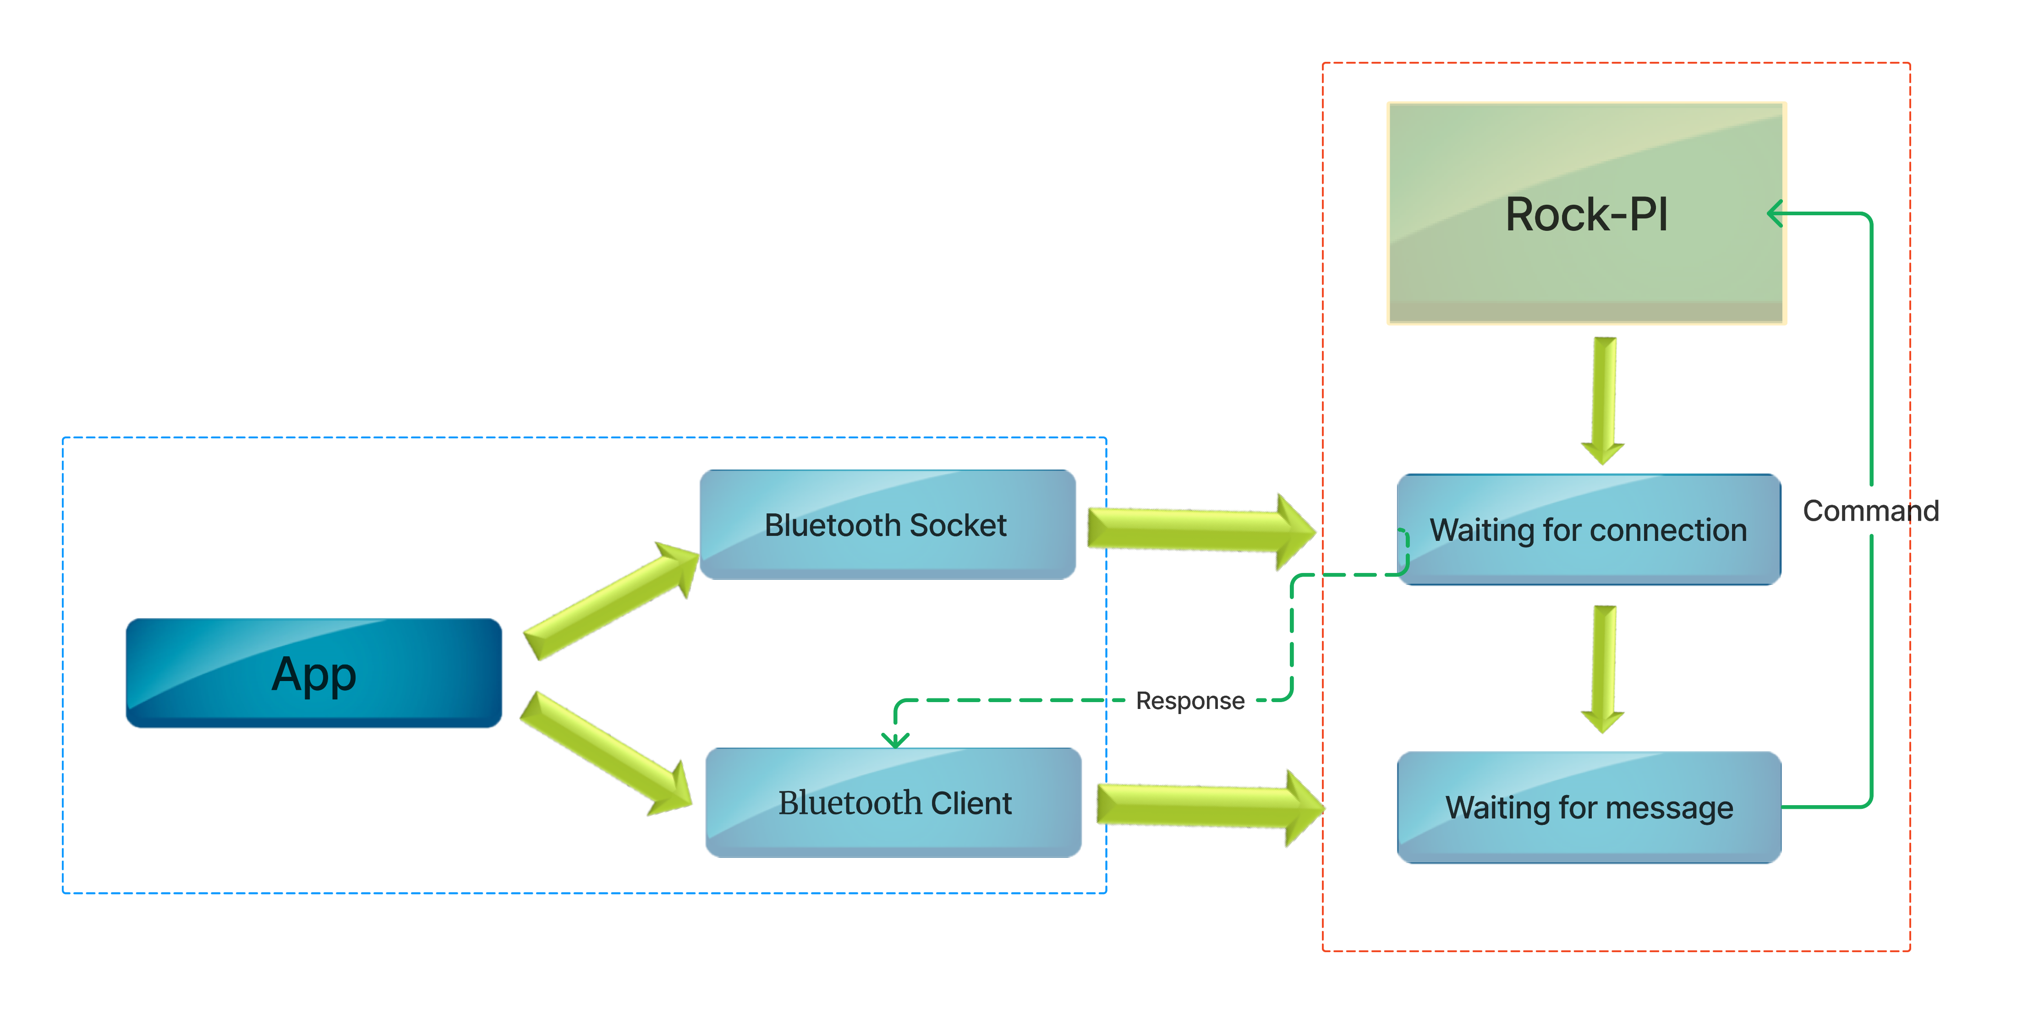
Communication System: Bluetooth
Short range data communication
Instant actions
Very low to no latency
A range of approximately 20 meter radius

Slide 10
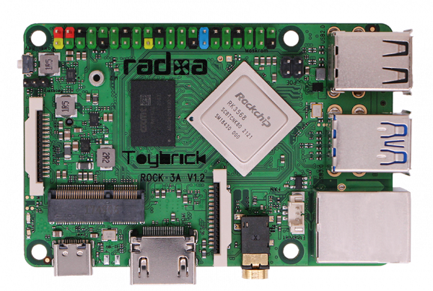
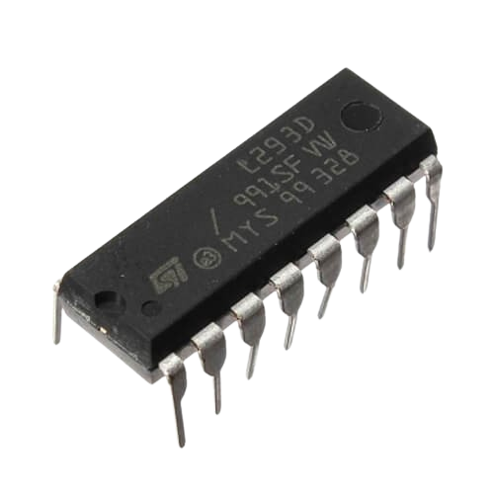
Hardware Design
4 main components:
Rock Pi 3a Micro-controller
L293D Motor Driver
Web-Cam
Python scripts through Debian OS from the micro-controller

Slide 11
Experimental Analysis
Processing Issues
Multiple types of data arrives at the same time
Multiple types of data leaves at the same time
Might cause conflict in scheduling
Increases latency
Overlapped data could be lost
Solutions
Parallel Execution - 2 separate execution: I. Camera Stream & II. Python Scripts
Multi-threading - 4 different threads: I. Write/Update, II. Bluetooth, III. Socket/IoT & IV. Read

Slide 12
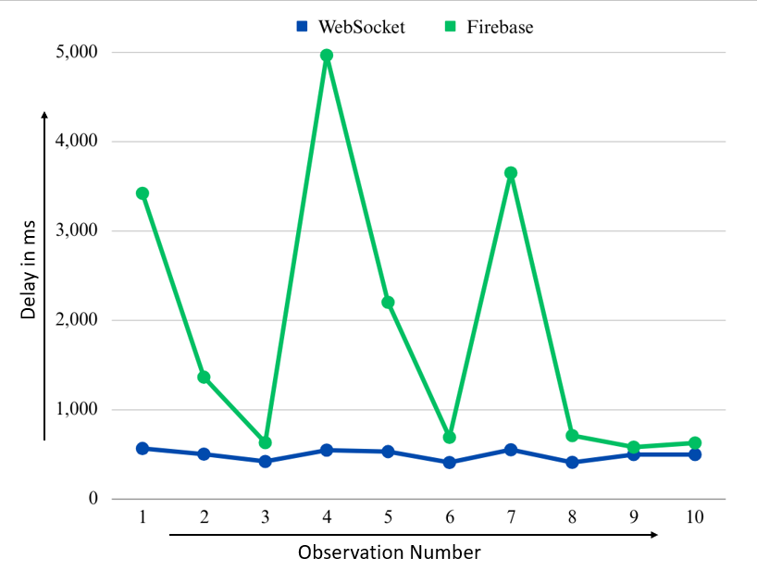
IoT Issues and Solutions
Latency
Web Socket has significantly less latency (499 ms) than Firebase database (1534 ms) in a 5 Mbps connection
Multiple users accessing at the same time
Single User Access
Delay System
Trade-off: Multiple user access inversely proportional to stability and latency
A middle ground of 0.5 sec delay is set

Slide 13
Applications
Voice-controlled and IoT enabled wheelchair
Smart retail
Security systems
Research and exploration
Assistive robotics

Slide 14
Future Work
Implement more advanced voice recognition models for enhanced accuracy and multilingual support
Investigate autonomous navigation capabilities, including obstacle detection and collision avoidance
Implement additional features, such as gesture-based controls, EEG etc.
Conclusions
Combined IoT, Bluetooth and Bengali voice Control System
Could serve as a step towards smart vehicular systems

Slide 15
Thank You

